Slide 1



Netra: Safe Screen Distance Detection
Maanya Mishra
Disha Singh

Slide 2
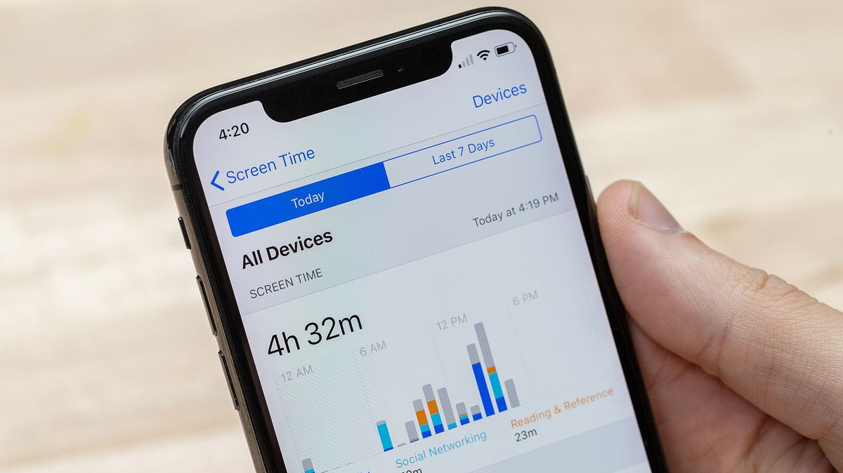
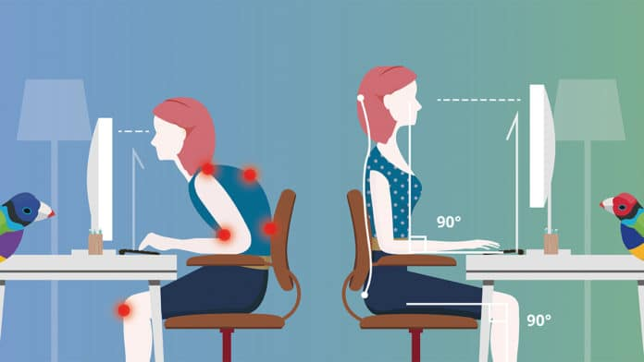
Objectives
Assist user in maintaining a safe distance from the screen to drive them to sit in a comfortable posture, lessening stress on both eyes and body
Assist in managing eye breaks or to understand their level of distraction by showing total screen viewing time

Slide 3
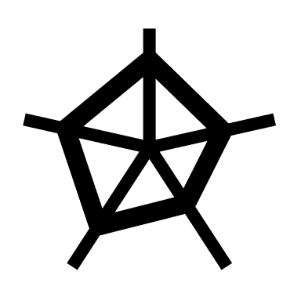

Limitations of Current Practices
Distance detection using LiDAR
Detection using SoundWave by Microsoft Research
Expensive to use sensors like LiDAR, for accurate measurements
A single speaker cannot detect the sound waves from multiple sources.
Applications have been made only for android phones
Notes:
46.51% of web traffic comes from desktop devices. Meaning a considerable portion still works on laptops/desktops.

Slide 4
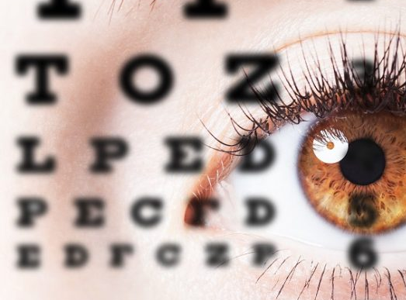
Benefits of our Approach
Not just find distance, advise the user from a health standpoint
A minimal software (browser extension) needs to be installed
Can be extended to multi-user scenario
Works on laptops extendable to mobile phones

Slide 5
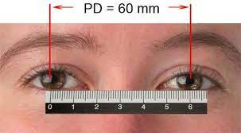
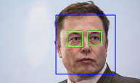
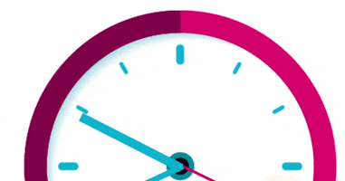

Approach
Using OpenCV, find IPD from reference image whose distance from screen is known.
Hard Code these
Found IPD_ref = 260 pixels for an image taken 30 cms far away from the screen.
For every user, calibrate the hard coded values for specific screen size
Perform Eye Detection using webcam to measure IPD thus find distance from screen
Compare with safe distance of 51cm
Enabling timer in background that increments only when you look at the screen
$$\frac{IPD ref}{Distance ref} =\frac{IPD estimated}{Distance unknown}$$

Slide 6
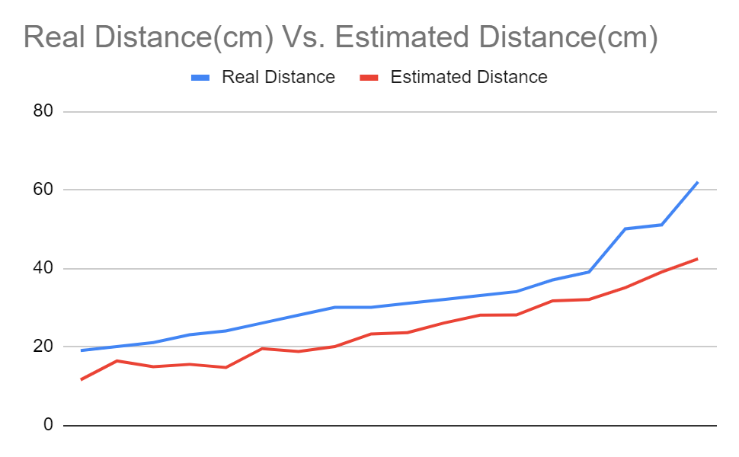
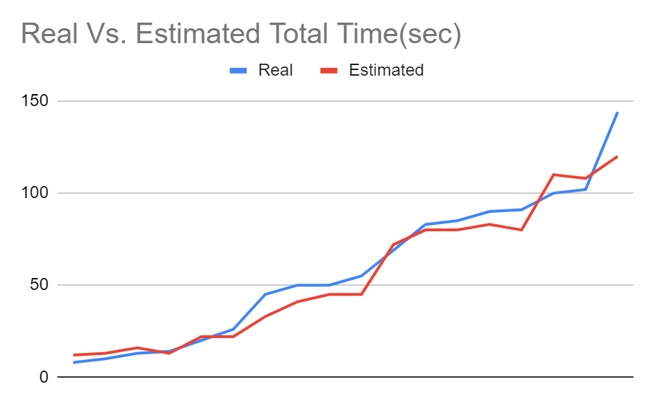
Evaluation
What Users think??
Do you think it is useful? | What privacy issues concern you? | Will you use it given its current state? | Thoughts on total viewing time? | Challenge as of current technology
Mean Error: 7.58cm
Especially people with high power | As long as there is nothing in cache and there is clear transparency of data collected | Sure! If concerns are solved | Better than iPhone screen time which keeps counting time even when phone is idle with just screen on | With spectacles on, Netra had a hard time detecting eyes, especially in dim light
Mean Squared Error: 8.41sec

Slide 7
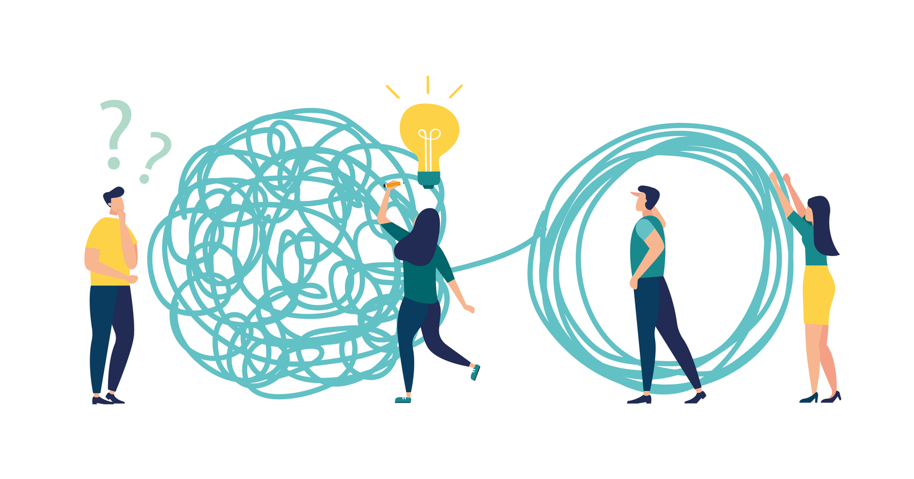
Challenges
Building two new skills: OpenCV, browser extension building in time constraint
Huge time taken by each run of face detection classifier
Webcam needs to be on all the time causing high power consumption and privacy concerns
Doesn’t work when browser is closed
Time increased when I looked at keyboard while typing
Since eyes are detected by circles, the system is set to freeze when more than 2 eyes are detected

Slide 8
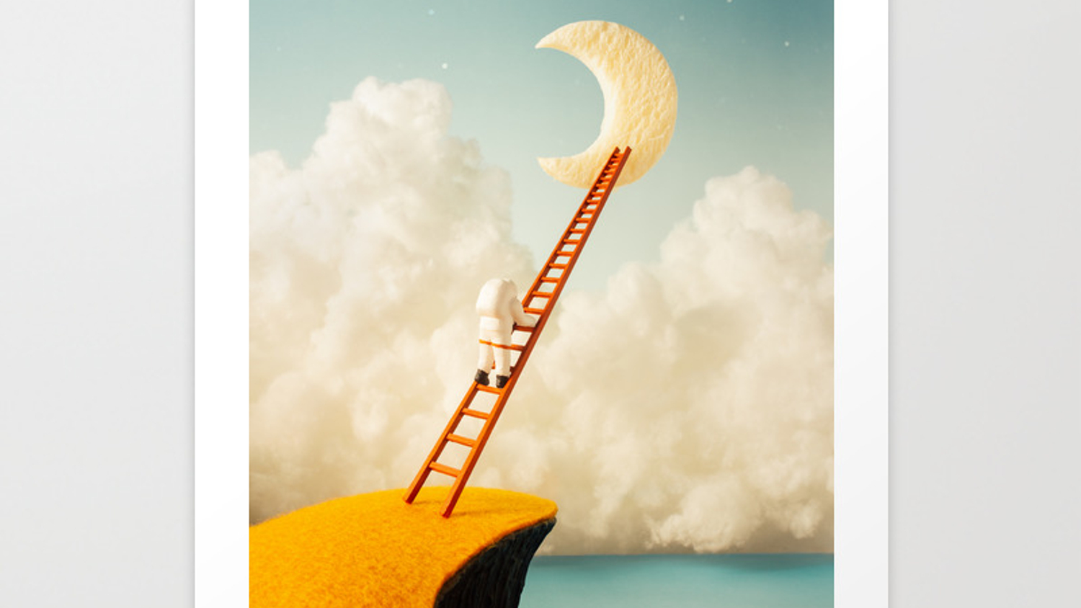
Future Potential
Allowing user to decide the time after which the system alerts him to stay at a safe distance
Approach replication in Java for desktop apps
Chrome background extensions that send notifications to desktop when browser is closed
Just wondering??: Quantization of harcascade face detection classifier to run optimally on mobile devices
A parental control option to freeze the STAY AWAY popup unless the user moves to a safe distance
The JavaScript code can be migrated easily to any react native app to work on cell phones

Slide 9

Thank you Remember to keep your eyes healthy!

